Slide 1
Data REPLY FR – CEGID
A GENERATIVE AI ASSISTANT

Slide 2
Project overview
Migrate and modernize phase
Public RAG solution
Multi-tenancy
Next steps
Assess phase

Slide 3
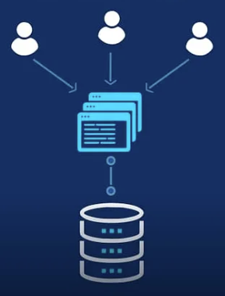
Project overview
RAG solution to assist Cegid's customers while completing the tax forms
Multi-tenancy solution designed to cater to the diverse needs of multiple Cegid's customers or "tenants" within a single and shared application

Slide 4

Assess phase:
We successfully held two assessment workshops to define the scope of the project, establishing a solid foundation for our future activities:
Workshop 1: tax forms filling process and types of documentary sources
Workshop 2: Tips and recommendation to generate a reference dataset

Slide 5

Knowledge Base source documents:
The team has identified the source documents for the knowledge base, categorizing them into three main types:
Public Knowledge Base: Data extraction is underway from the websites of Bofip and Légifrance.
Cegid Knowledge Base: The data extraction has been completed, and the information has been shared by the Cegid team.
Private Knowledge Base: Data for this phase will be shared in the second stage of the PoC implementation.

Slide 6
Migrate and modernize phase
1st phase: RAG solution on public and Cegid knowledge base
2nd phase: multi-tenancy solution for private knowledge bases

Slide 7
RAG (Retrieval-Augmented Generation)
RAG (Retrieval-Augmented Generation) :
Simply put, it is a strategy that boosts FMs by incorporating external data sources. This enhancement enables the models to generate answers that are contextually aware, leading to the discovery of valuable insights.
By fetching data from company data sources and feeding the prompt with that data, it helps deliver more relevant and accurate responses.
Foundation Models:
Foundation models refer to the large, pre-trained language models that serve as the basis for various downstream natural language processing (NLP) tasks.
These models are trained on massive datasets and have a broad understanding of natural language. They are capable of general language understanding and can be fine-tuned for specific tasks.
Amazon Kendra :
As per the AWS website: “Amazon Kendra is an intelligent enterprise search service that helps you search across different content repositories with built-in connectors”.
It connects multiple data repositories to an index, ingesting and crawling documents and websites into it. This leads to a more robust search experience.
Amazon Bedrock :
Amazon Bedrock is a serverless service that makes it easy to build and scale generative AI applications using foundation models via a single API.
These FMs are from leading AI companies like Anthropic(Claude Model), AI21 Labs (Jurassic Model), Cohere(Command and Embed Model), Meta (Llama 2 Model), Stability AI(Stable Diffusion XL Model), and Amazon(Titan Model).
It supports the customization of models to suit personal requirements using fine-tuning. Also, it supports RAG through its Knowledge Base(KB) feature.
Claude 2 :
Claude 2 is a large language model, it can generate any type of written text, summarize your existing texts and help you in your research. Thanks to its large input capacity, you can summarize hundreds of pages of documents in just a few minutes using Claude 2.
LangChain :
LangChain is used to build chatbots or personal assistants, to summarize, analyze, or generate Q&A over documents or structured data, to write or understand code, to interact with APIs, and to create other applications that take advantage of generative AI

Slide 8
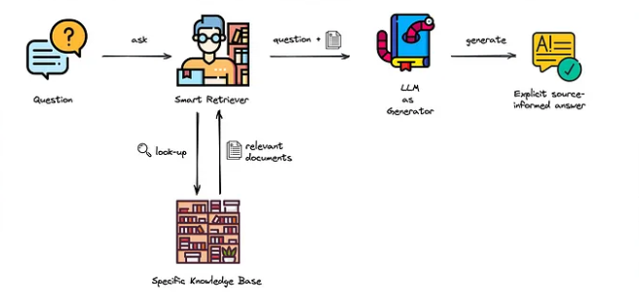
RAG (Retrieval-Augmented Generation)
Retrieval: In the context of RAG, retrieval involves fetching relevant information from a pre-existing knowledge base or external data source. This knowledge base could be a collection of documents, articles, or any structured data that contains information related to the task at hand ,In this project we use documents pdf in s3 or websites also we use kendra to scan this data source
Generation: Generation refers to the ability of the model to create new, coherent, and contextually appropriate text. This is typically achieved using techniques such as autoregressive language modeling or transformer-based architectures ,in this case bedrock with model claude v2
Integration of Retrieval and Generation: RAG combines these two approaches in a synergistic manner. The model uses retrieval mechanisms to gather pertinent information from the knowledge base, and then incorporates this retrieved information into the generative process. This allows the model to leverage both the benefits of pre-existing knowledge and the capacity to generate contextually relevant responses or content.
Context-Aware Responses: By integrating retrieval and generation, RAG models are capable of producing responses that are not only influenced by the input context but also enriched by information retrieved from external knowledge sources. This context-awareness enhances the model's ability to provide more accurate and informative responses.
Applications: RAG models find applications in various NLP tasks, including question-answering, dialogue systems, content creation, and information summarization. The ability to retrieve information from a knowledge base allows the model to have a broader understanding of the context and generate more informed and contextually relevant responses.

Slide 9
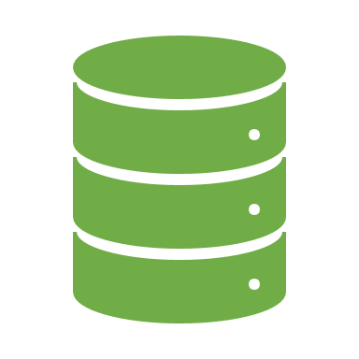
1st phase: RAG on Public and Cegid knowledge bases :
The 1st phase of implementing the RAG architecture on AWS is focused on the Public and Cegid knowledge bases to validate the solution's performance on these databases.
The Reply team has made significant progress, implementing the designed RAG architecture for Public and Cegid knowledge bases. Key accomplishments include:
Definition of data extraction strategies, including web scraping or uploading PDFs in S3.
Implementation of Kendra indexes for public knowledge bases.
1st phase tested by Reply team and waiting for cegid validation using the reference dataset that should be provided by Cegid

Slide 10
Multi-tenancy approaches:
2nd phase: multi-tenancy solution for private knowledge bases
Multi-Tenancy with Opensearch: Assigning one index to each client, though with more steps required for data crawling and preparation. For this approach, we are limited to 20 indexes per region
01
Multi-Tenancy with Kendra (Index Technique): Assigning one index to each client, a simpler method for multi-tenancy with Kendra, limited to 5 indexes per region.
02
Multi-Tenancy with Kendra (Filtering Technique): Utilizing facets and metadata filtering to handle multi-tenancy, allowing integration of private knowledge bases
03

Slide 11
Opted approach Multi-tenancy with kendra (Filtring Technique):
Option 1
Option 2
Option 3
Option 4
The number of indices will be managed by Cegid, a new index will be created if the previous one is saturated.
Each data source will be assigned to a Cegid client
One index =50 datasources, with
5 datasources dedicated to
Cegid's public links/data and the remaining 45 datasources for Cegid's clients.
In the case of PDFs or other file types: Client data will be stored per bucket ==> one bucket = one client.
Notes:
Leon 1

Slide 12
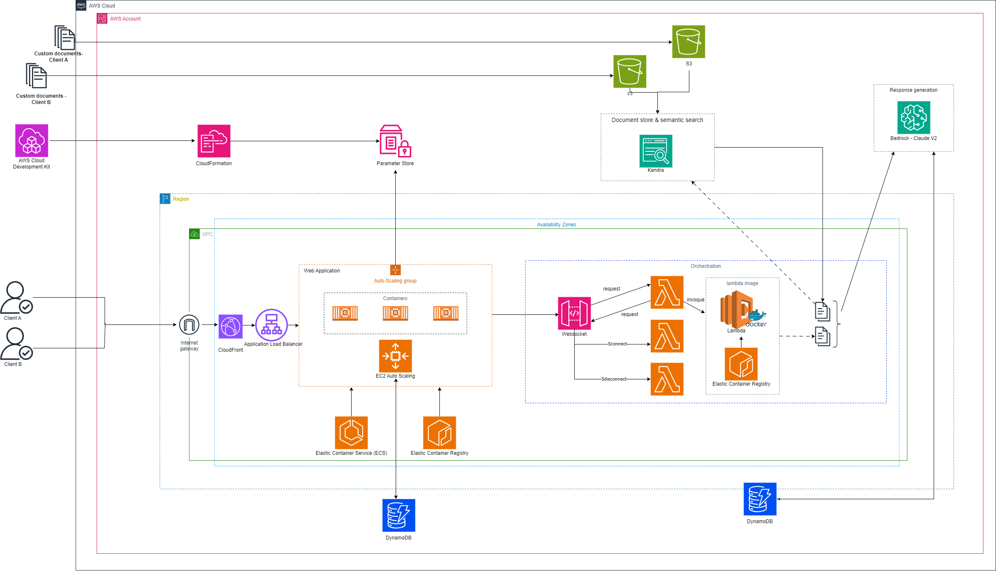
Opted approach Multi-tenancy with kendra
Technical Architecture

Slide 13


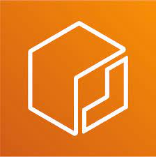
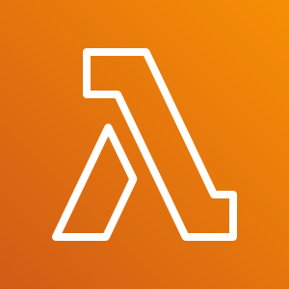
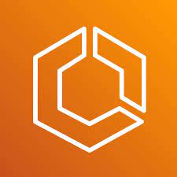
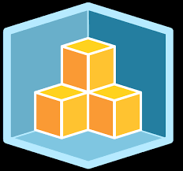
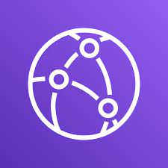

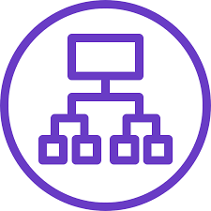


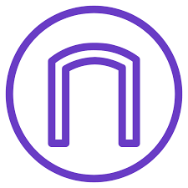
Opted approach Multi-tenancy with kendra
Technical Architecture
 | Handle more than 10 trillion requests per day and can support peaks of more than 20 million requests per second. Secure your data with encryption at rest, automatic backup and restore, and guaranteed reliability with an SLA of up to 99.999% availability. Focus on innovation and optimize costs with a fully managed serverless database that automatically scales up and down to fit your needs. Integrate with AWS services to do more with your data. Use built-in tools to perform analytics, extract insights, and monitor traffic trends. https://aws.amazon.com/pm/dynamodb/
 | Amazon Elastic Container Registry (Amazon ECR) is a fully managed container registry offering high-performance hosting, so you can reliably deploy application images and artifacts anywhere. https://aws.amazon.com/ecr/
 | Amazon Elastic Container Service (ECS) is a fully managed container orchestration service that helps you to more efficiently deploy, manage, and scale containerized applications. It deeply integrates with the AWS environment to provide an easy-to-use solution for running container workloads in the cloud and on premises with advanced security features using Amazon ECS Anywhere. https://aws.amazon.com/ecs/
 | CloudFront :Securely deliver content with low latency and high transfer speeds . Amazon CloudFront is a content delivery network (CDN) service built for high performance, security, and developer convenience. https://aws.amazon.com/cloudfront/
 | Application Load Balancer operates at the request level (layer 7), routing traffic to targets (EC2 instances, containers, IP addresses, and Lambda functions) based on the content of the request. Ideal for advanced load balancing of HTTP and HTTPS traffic, Application Load Balancer provides advanced request routing targeted at delivery of modern application architectures, including microservices and container-based applications. Application Load Balancer simplifies and improves the security of your application, by ensuring that the latest SSL/TLS ciphers and protocols are used at all times. https://aws.amazon.com/elasticloadbalancing/application-load-balancer/
 | An internet gateway enables resources in your public subnets (such as EC2 instances) to connect to the internet if the resource has a public IPv4 address or an IPv6 address. Similarly, resources on the internet can initiate a connection to resources in your subnet using the public IPv4 address or IPv6 address https://docs.aws.amazon.com/vpc/latest/userguide/VPC_Internet_Gateway.html
 | Amazon Simple Storage Service (Amazon S3) is an object storage service offering industry-leading scalability, data availability, security, and performance. Any Customer can store and protect any amount of data for virtually any use case (data lakes, cloud-native applications, and mobile apps). You can optimize costs, organize data, and configure fine-tuned access controls to meet specific business, organizational, and compliance requirements. https://aws.amazon.com/s3/?nc2=type_a
 | AWS Lambda is a serverless, event-driven compute service that lets you run code for virtually any type of application or backend service without provisioning or managing servers. You can trigger Lambda from over 200 AWS services and software as a service (SaaS) applications, and only pay for what you use. https://aws.amazon.com/lambda/
 | AWS CloudFormation enables you to manage your complete infrastructure or AWS resources in a text file, or template. A collection of AWS resources is called a stack. AWS resources can be created or updated by using a stack. https://aws.amazon.com/cdk/
 | Systems Manager Parameter Store provides secure storage and management of secrets. You can store data such as passwords, database strings, Amazon Elastic Compute Cloud (Amazon EC2) instance IDs and Amazon Machine Image (AMI) IDs, and license codes as parameter values.
 | You can now use Amazon Kendra with Large Language Models (LLMs) to quickly create secure, generative AI-powered conversational experiences for your users on top of your enterprise content. https://aws.amazon.com/kendra/
 | Amazon Bedrock is a fully managed service providing high-performing foundation models (FMs) from key AI companies via a single API. It offers capabilities for building generative AI applications with a focus on security, privacy, and responsible AI. Users can experiment with top FMs, customize them privately using techniques like fine-tuning and Retrieval Augmented Generation (RAG), and create agents for tasks within enterprise systems. Being serverless, Amazon Bedrock eliminates the need for infrastructure management, allowing secure integration and deployment of generative AI capabilities using familiar AWS services. https://aws.amazon.com/bedrock/

Slide 14
Next Steps
We are currently waiting for an evaluation dataset from Cegid to assess the first phase with both public and Cegid knowledge bases.
We are in need of samples from at least three different clients' documents to test the multi-tenancy approach on real-world datasets.

